Slide 1
Tutorial 3
T03/08
Week 5
gohruizhi@u.nus.edu

Slide 2
Recap: security questions
Fall back mechanism for authentication and password resets
- Weakens security for usability => Provides another avenue for potential attacks
- Commonly used, since it lowers the cost of manpower (customer service), allowing the user to self-help

Slide 3
Recap: security questions
Properties of Security Questions:
Memorable
Answers should be memorable. Otherwise, it has the same risk of forgeting
Consistent
Answers should not change overtime (E.g. What you ate for lunch?)
Nearly Universal
Question should apply to wide range of audience
Safe
Answer should not be easily guessed or searched

Slide 4
Discuss the following security questions
(a) “When did you graduate from college?”
Not safe: Easily searched on social media profile
Not universal: Some people didn't go to college
(b) "Which college did you graduate from?"
Not safe: Same as (a)
Not universal: Same as (a)
(c) "What is the name of your first pet?"
Not universal: Some people never own a pet in their life
Not safe(?): Possibly searched and inferred from social media profile

Slide 5
Discuss the following security questions
(d) "What is your favorite food?"
Not consistent: Today you might like Laksa, tomorrow you might like Pasta
(e) "What are your birthday and your spouse's birthday in MMDDYYMMDDYY format?"
Not safe: Easy to find out
Not universal: Not all people are married

Slide 6
Suggest a good security question
No perfect question
But we can always try to think out of the box when answering those questions
E.g.
Q: Who was your first love?
A: Chicken Nuggets

Slide 7
Question 2
You have intercepted two ciphertext C₁ and C₂, which were generated by stream cipher using the same key.
C1: 0111 1101 1011 C2: 0111 0010 1011
The first 4 bits of each ciphertext form the used IV. You know that the plaintext must be
among the following 4 sequences:
P1 = 00000000; P2 = 11111111; P3 = 00001111; P4 = 11000011:
What are the possible plaintexts of the captured ciphertexts C1 and C2?

Slide 8
Question 2
Same key and IV used!
=> Never repeat the use of IVs
Answer:
C₁ ⊕ C₂ = P_{a} ⊕ P_{b}
= 1111 0000
We just try all combinations
Only P₂ ⊕ P₃ match.

Slide 9
Question 2
Proof:
Let the pseudorandom sequence generated be K’
Since key and IV are the same for C₁ and C₂ , they will both have the same K’.
C = P ⊕ K’ //Stream Ciphers are basically a One Time Pad
C₁ ⊕ C₂ = P_{a} ⊕ K' ⊕ P_{b} ⊕ K' // K' ⊕ K' = 0
= P_{a} ⊕ P_{b} ⊕ 0
= P_{a} ⊕ P_{b}

Slide 10
Question 3
Consider two password authentication systems S-I and S-II:
S-I: After a user has entered his/her userid, the system sleeps for 0.5 seconds, and then checks whether the userid is in the database. If it's not in, the system sleeps for another 0.5 second, displays an error message, and then prompts for the new userid; Otherwise, the system prompts for the password. If the password is wrong, the system sleeps for another 0.5 seconds, and then prompts for the new userid again.
S-II: After a user entered his/her userid and password, the system sleeps for 0.5 second, and then checks whether the entered credential information is correct. If it is wrong, the system sleeps for another 0.5 second, displays an error message, and then prompts for the new userid and password again.
What are the security implications of the two different checking mechanisms adopted by S-I and S-II?

Slide 11
Question 3
Ask for User ID
Check User ID
Ask for Password
Check Password
S-I:
Suppose attacker is going to guess, how many guesses does he need?
Let X = # of guesses for User ID
Let Y = # of guesses for Password
Number of guesses =X + Y

Slide 12
Question 3
S-II:
Ask for User ID and Password
Checks User ID and Password
Suppose attacker is going to guess, how many guesses does he need?
Let X = # of guesses for User ID
Let Y = # of guesses for Password
Number of guesses = XY
Have to guess both together!

Slide 13
Question 3
Note:
Notice that, in practice, User ID is not a secret. But for a layered defence, it is good to hide it as much as possible.
Ultimately, the security still relies on the password.

Slide 14
Question 4
A university library provides a Web-based service for the students to renew their books. To get authenticated, a student may key in Student ID, DOB (DDMMYYYY) and family name. After authenticated, the list of books borrowed by the student is displayed, and then the student can choose which book(s) to be renewed. No other action can be performed through this service.

Slide 15
Question 4
(a) What are the advantages of the authentication mechanism above compared to the typical password-based authentication?
There's no bootstrap process needed to setup user passwords
Account has been set up for you
Login information needed are easy to remember
Just student ID, DOB, family name

Slide 16
Question 4
(b) What are the weaknesses of the system above? Are there any concerns on the students’ privacy?
There is a potential security and privacy breach:
1. If an adversary knows a student’s social information (easier to find out than a random password), then he can log in to see the books being borrowed by the student
2. If the adversary knows only a student’s ID and family name, then he can still probe the login screen to find out the birthday (why?), and subsequently find out the books being borrowed the student.
Age is easy to guess! University students => 20 – 24 year olds
Birthday => Just 365 days to guess

Slide 17
Question 4
(c) Do you prefer the above authentication, or the typical password-based authentication to be used by the university?
No right or wrong answer. It's just a usability – security tradeoff problem.

Slide 18
Question 4 discussion
What’s the big deal?
=> Attacker would just find out the books I borrow… no big deal… or is it?
Consequences:
1. Monetary costs
Borrowing under your name and not returning
2. Profiling
A lot of information can be inferred once someone knows the books you read!!!
Your major, interests, personal needs/problems, strengths/weakness, ambition/life goals
An avenue for other attacks, e.g. scams, identity theft

Slide 19
Question 5
A bank's IT team is planning to enhance the password + SMS 2FA of its online banking service. To use the service, a user first logs-in using the password (without the SMS) using his/her PC. After the user has logged in, the user's account number would be displayed on the PC, together with a few transaction options. If the user wants to transfer money to another account, the following steps will be carried out:
The user enters the required transaction information (account number and amount) to the PC, which in turns sends the information to the server.
The server sends an OTP to the user via SMS. The SMS will be delivered to the user's mobile phone by the telecommunications service provider (e.g. Singtel, M1 or Starhub).
The user enters the OTP to the PC, which in turn sends the OTP to the server.
The server checks the sent OTP and, upon receiving a valid OTP, sends a confirmation to the user's PC.
After receiving the confirmation from the server, the PC finally displays a message "transaction completed".

Slide 20
Question 5
Now, the IT team has to decide what information to be included in the SMS in step (2).
Below are examples of two considered choices:
M-I: "Enter OTP 132373 to complete your transaction."
M-II: "You have requested to transfer $10,000 from account no 1388293-43-23 to account no 12398-234-A2. Enter OTP 132373 to complete your transaction."
(Hint: You can consider the fact that a SMS is not encrypted in an "end-to-end" fashion, and there could be multiple telco entities handling the SMS. You can also consider the scenario where the PC is in an Internet cafe, and the cafe owner could be malicious, or honest but curious.)

Slide 21
Question 5
(a) Give a situation where M-I is preferred
M-I is more secure (Less information shown)
If phone is lost and adversary found and accessed it, he cannot learn about the transaction.
SMS is not encrypted. If SMS is sniffed, no information leaked

Slide 22
Question 5
(b) Give a situation where M-II is preferred
M-II provides clarity and verification
If PC is infected and redirects transactions to attacker account, SMS displays a different destination account
Help the user verify if his/her money is transferred correctly.

Slide 23
Question 5
(c) If you were the IT team, which message format would you choose?
It depends on the application and situation, but both are not that good….
Show just enough information for verification:
E.g.
"You have requested to transfer $10,000 from account no XXXXXX3-43-23 to account no XXXXXX34-A2. Enter OTP 132373 to complete your transaction."

Slide 24
Question 6
You are shipping WLAN access points. Access to these devices is protected by password.
(a) What are the implications of shipping all access points with the same default password?
(b) What are the implications of shipping each access point with individual password?
(Hint: Argue from the viewpoint of usability vs security)

Slide 25
Question 6
(a) What are the implications of shipping all access points with the same default password?
An attacker can access a device if the default password is not changed
Note: Most default passwords, especially for routers, can be googled. Always change default passwords

Slide 26
Question 6
(b) What are the implications of shipping each access point with individual password?
Manufacturer's perspective – Cost increased:
Printing password on equipment/manual
Difficult to print on equipment in manufacturing pipeline (Possibly separate supply lines?)
Tracking every password in case of customer support (Database + Customer Service)
User's perspective – Reduced usability
If password is lost, need help from customer service (Troublesome)

Slide 27
Question 7
A company has installed fingerprint-based door access systems at their server room and gym.
The two systems are exactly the same, but the company set different thresholds to adjust the false non-match rate (FNMR) and false match rate (FMR).
Suppose the threshold set for the server room is 0.5, what would be a reasonable threshold to set for the gym: larger, smaller or equal to 0.5?

Slide 28
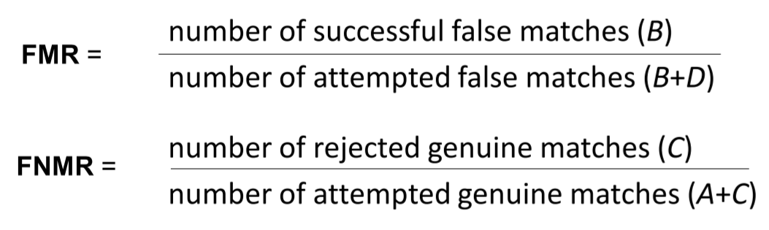
Recap: FMR & FNMR
// You shouldn't get in but you did
// You should get in but you didn't

Slide 29
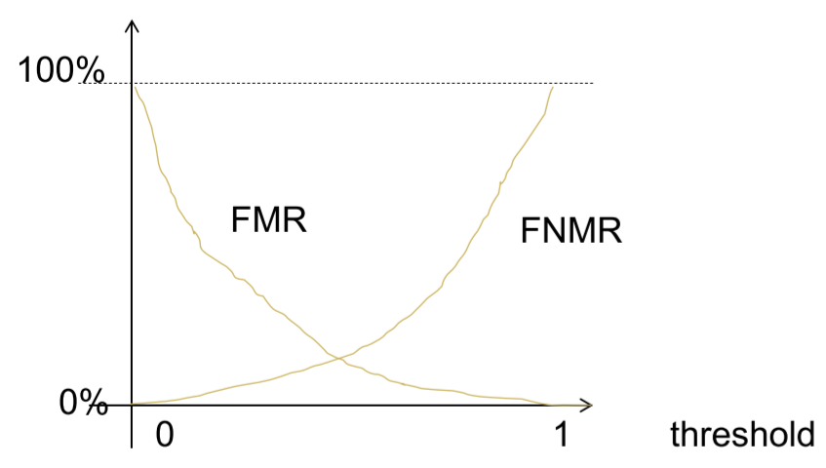
Recap: FMR & FNMR
• Lower threshold → more relax in accepting
• Higher threshold → more stringent in accepting

Slide 30
Question 7
What would be a reasonable threshold for the gym: larger, smaller, or equal to 0.5?
Gym less important than server room => Can be more relax => FMR can be higher
Threshold smaller than 0.5 is reasonable
Notes:
If threshold = 1, everyone is locked out (False non-match rate = 100%)
If threshold = 0, why even install the lock?

Slide 31
Question 8
Remember to look up the definitions and people and put them in your cheat sheet! They are tested for your upcoming midterms!

Slide 32

Thank you
Any questions?

